Slide 1
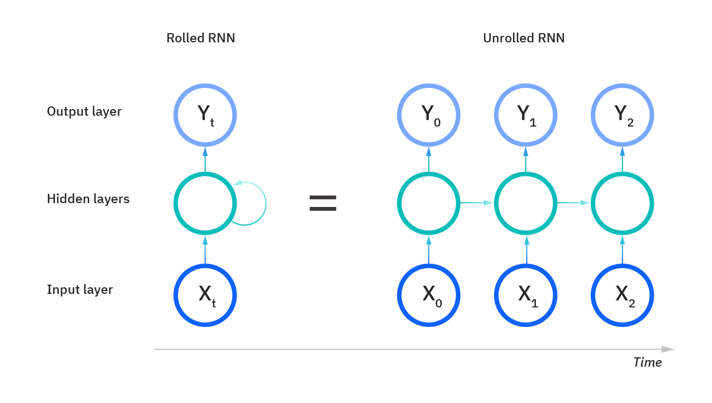
METHODOLOGY[2] – RECURRENT NEURAL NETWORK
Recurrent Neural Networks (RNNs) “remember” information from previous inputs to influence later inputs and outputs
Commonly used with natural language data or time series, where order matters
Our models:
Two linear hidden layers with Leaky ReLU activation functions, batch normalization between layers, and one linear output layer.
Reserved 20% of data for test set, ~last two years, and 16% for validation set
Batch normalization and dropout regularization
Feature extraction:
100 lags
One-hot encoded information about time interval (day of week, month of year, etc.)
Via IBM

Slide 2
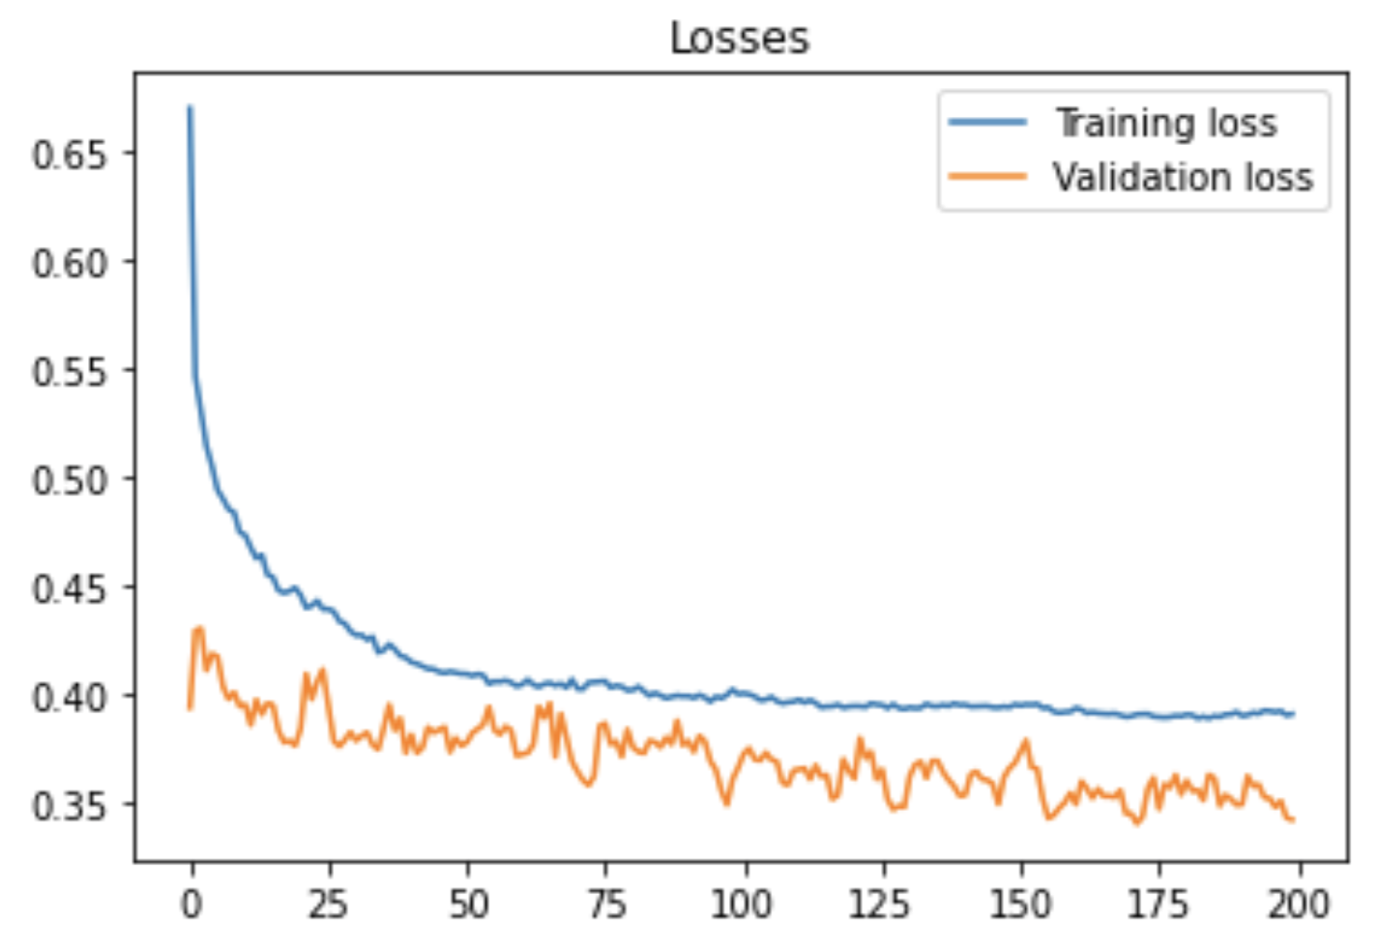
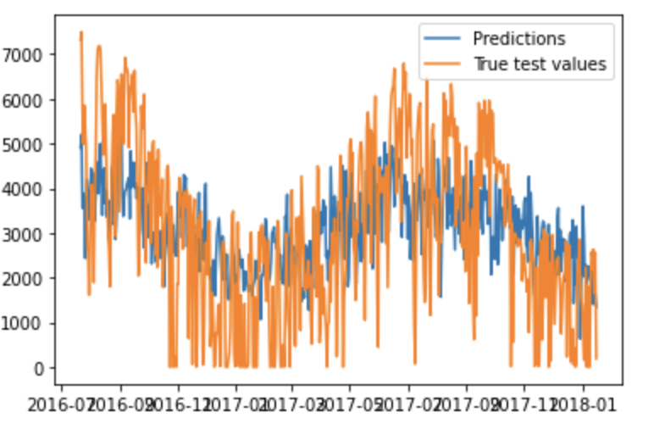
METHODOLOGY[2] – RECURRENT NEURAL NETWORK
Performance on test set

Slide 3
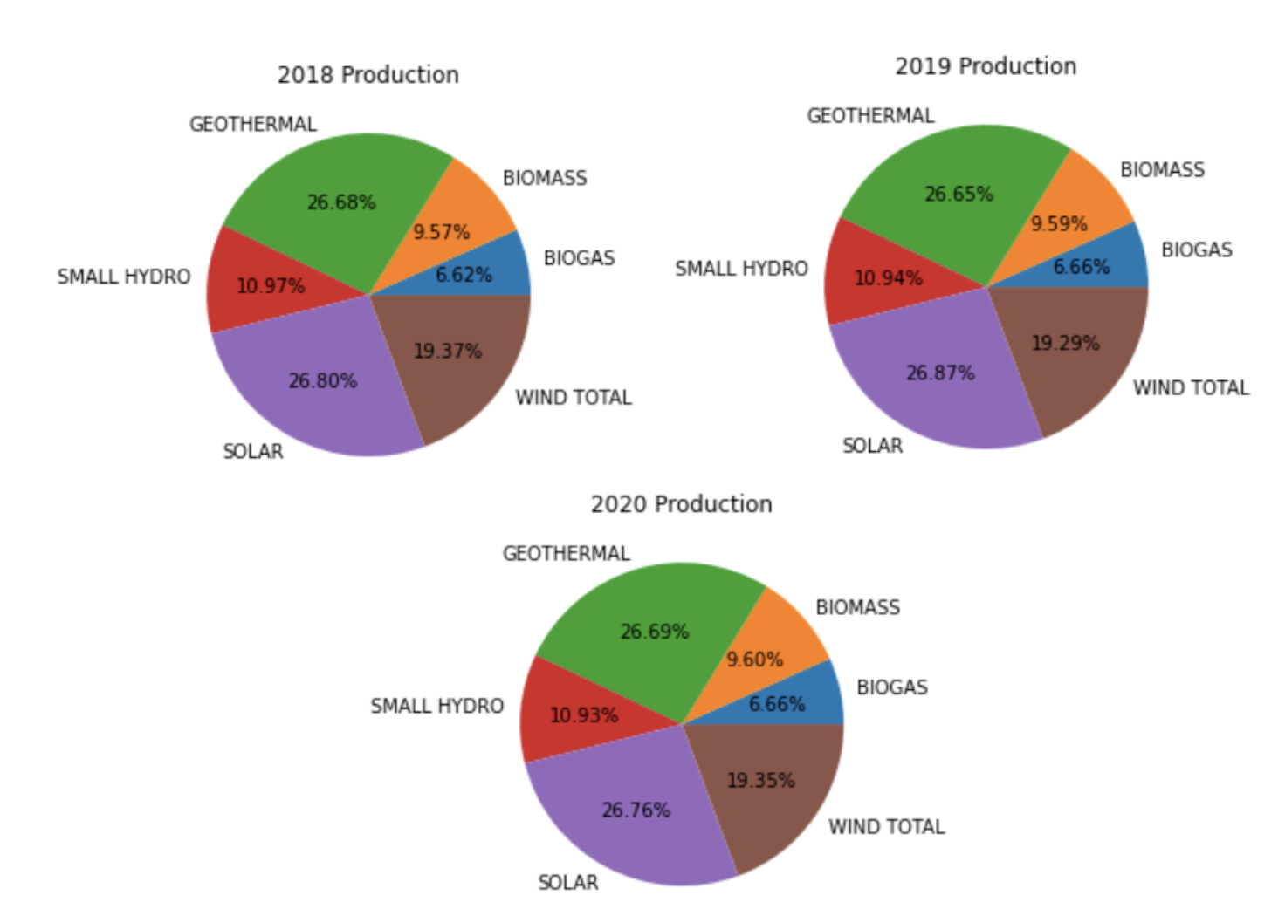
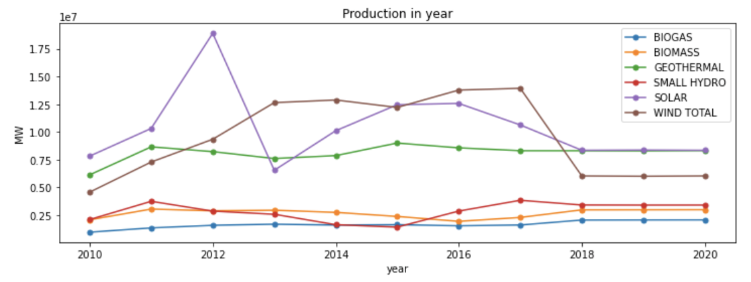
METHODOLOGY[2] – RECURRENT NEURAL NETWORK
Forecasting: what went wrong?
Overfitting on test set
Validation loss stayed relatively constant
Loss function never “converged”
Forecasts closer to earlier years than later
Lack of useful features
Model learned seasonality of green energy production, but not overarching trends
Learned to cut out noise
Wrong assumptions about the data
Independence between means of production allowed for simplicity of model and outputs

